Slide 1
Robot system - Sustainable Automation & Robotics
Dr. Mikael Ericsson

Slide 2
Sustainability Introduction

Slide 3
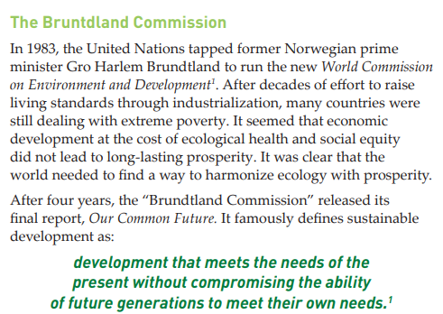
Sustainability Definition
UN document - The Bruntdland Commission report
Sustain + ability = Ability to maintain a certain rate or level or status
Sustainability consists of fulfilling the needs of current human generations without compromising the needs of future generations.

Slide 4
Other Sustainability Definitions
It is a societal goal that aims for humans to safely co-exist on the earth over a long time.
In ecology: maintaining biological resources diverse, robust, and productive
over time.
In business and policy: Seeking to prevent the depletion of natural or physical resources, so that they will remain available for the longer term.

Slide 5
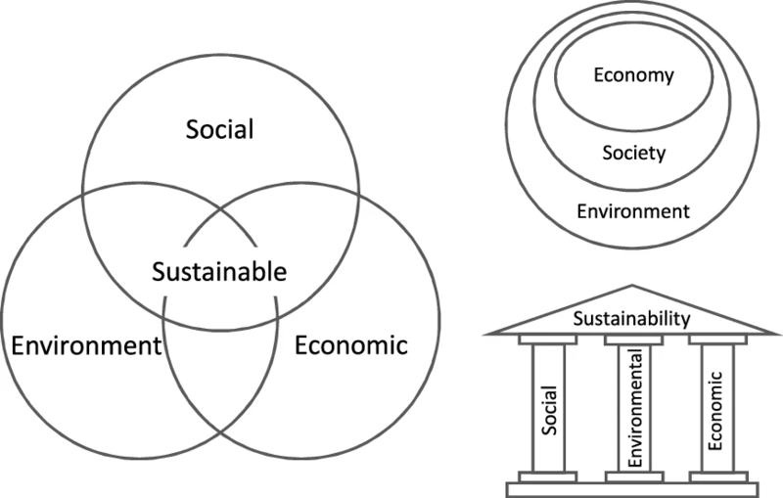
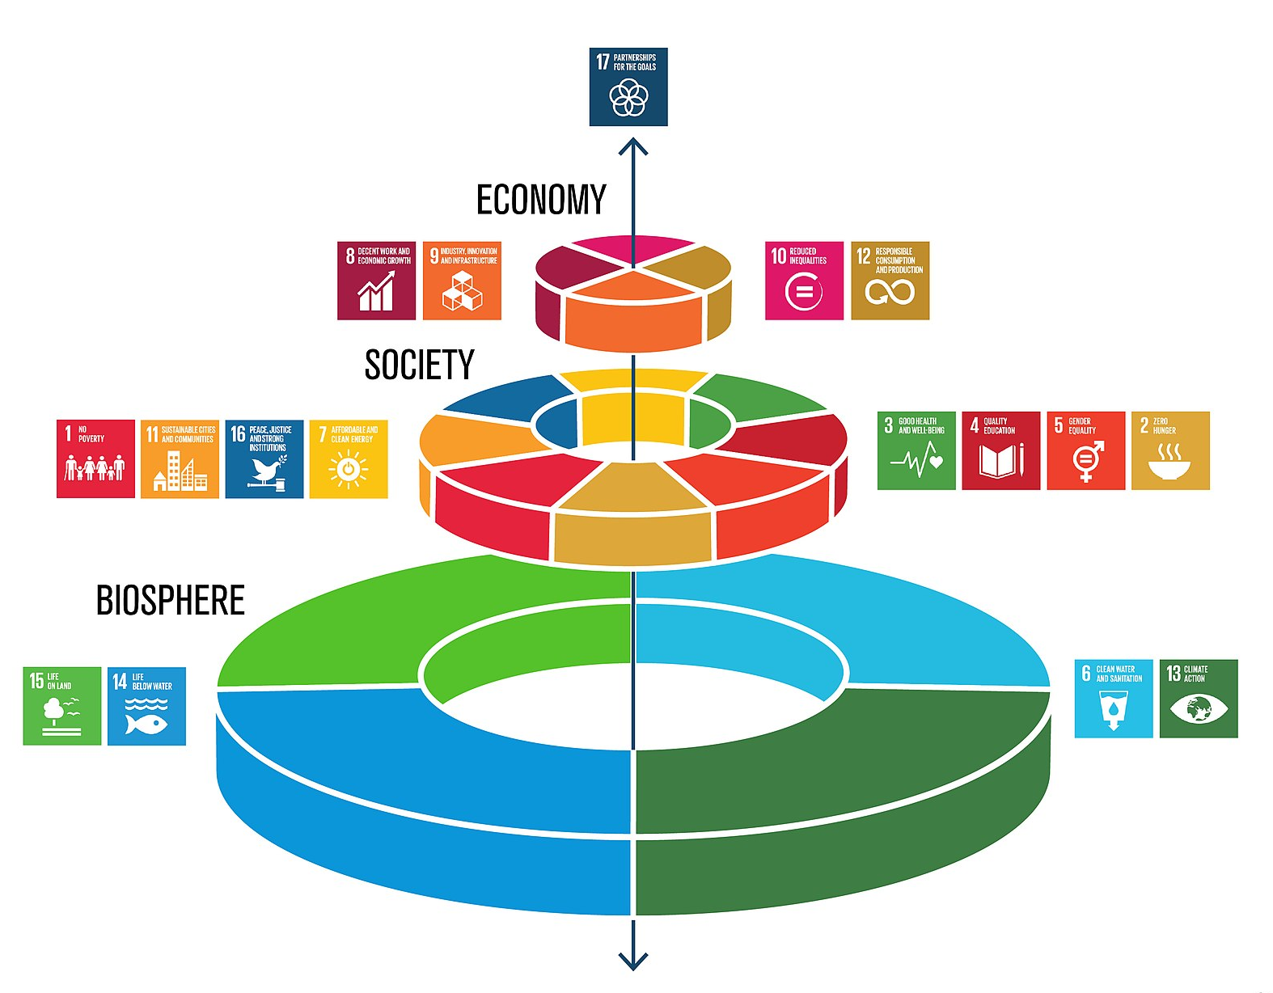
Sustainability Pillars and Development Goals (SDGs)
Environmental
Social
Economic

Slide 6

Sustainability Development Goals (SDGs)
GOAL 1: No Poverty
GOAL 2: Zero Hunger
GOAL 3: Good Health and Well-being
GOAL 4: Quality Education
GOAL 5: Gender Equality
GOAL 6: Clean Water and Sanitation
GOAL 7: Affordable and Clean Energy
GOAL 8: Decent Work and Economic Growth
GOAL 9: Industry, Innovation and Infrastructure
GOAL 10: Reduced Inequality
GOAL 11: Sustainable Cities and Communities
GOAL 12: Responsible Consumption and Production
GOAL 13: Climate Action
GOAL 14: Life Below Water
GOAL 15: Life on Land
GOAL 16: Peace and Justice Strong Institutions
GOAL 17: Partnerships to achieve the Goal
United Nation’s 17 sustainable development goals to transform our world

Slide 7
SDG and Robotics and automation
SDGs that suit robotics and industrial automation
SDG 8: work, work environment and economic development.
SDG 9: Industry, Innovation and Infrastructure.
SDG 12: resource efficiency, waste and circular production.
SDG 13 → energy and climate impact.
Robots and automation aims to solve and improve
Dangerous or ergonomically stressful tasks,
Improve quality and reduce scrap;
Enable dismantling, reuse and sorting;
Create more flexible and resource-efficient production.

Slide 8
Robotics for sustainability
How robots can contribute to:
reduced material waste,
energy-efficient production,
repair and remanufacturing;
sorting and recycling;
precision agriculture;
inspection of energy systems;
safer and more ergonomic work.

Slide 9
Sustainability of robotics
The robot's own impact through:
materials and components;
critical raw materials and electronics;
manufacturing and transportation;
energy use during operation;
maintenance and spare parts,
service life, upgradability and repairability;
dismantling, reuse and recycling.

Slide 10
Robot Life Cycle
Raw materials → Components → Robot manufacturing → Integration → Operation → Maintenance → Upgrading → Reuse/remanufacturing → Recycling/end of life
Embodied impact, impact from materials and manufacturing,
operational impact, especially electricity and consumables during operation,
avoided impact, such as reduced scrap or replaced hazardous work,
end-of-life impact, dismantling, reuse and recycling.

Slide 11
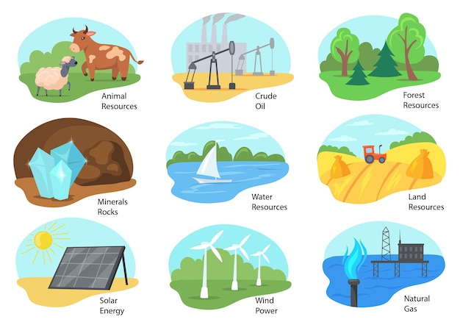
Natural Resources
Natural Resources are resources that are drawn from nature (Earth) and used with few modifications to sustain human life.
Sunlight
Atmosphere
Water
Land
Minerals
Vegetation
Wildlife

Slide 12
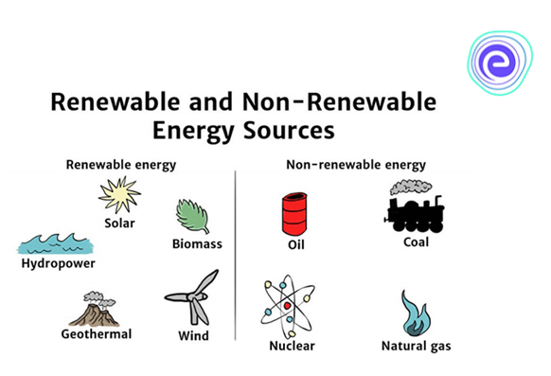
Renewable and Non-Renewable Resources
A Renewable Energy is a Natural Resource that can be replenished naturally over time.
They offer CLEANER energy solutions.
They are especially important because they are rather INFINITE.

Slide 13

Major Benefits of Renewable Energy
  Less Global Warming
  Improving Public Health
  Inexhaustible Energy
  New Jobs and other Economic Benefits
  Stable Energy Prices
  Reliability and Resilience

Slide 14
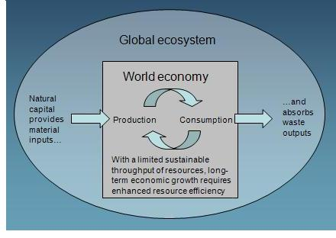

Efficient Use of Natural Resources
Economy relies on sustainable ecosystem (providing resources, and absorbing the waste and pollution)
Natural Resources are capitals! If we maintain them then they provide us constantly and over-exploiting reduces their capacity later.
We can't keep taking ever more resources from the environment and generating ever more waste!
https://www.eea.europa.eu/themes/waste/resource-efficiency/why-is-resource-efficiency-important

Slide 15
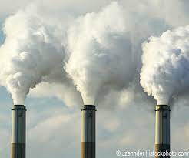
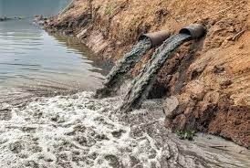
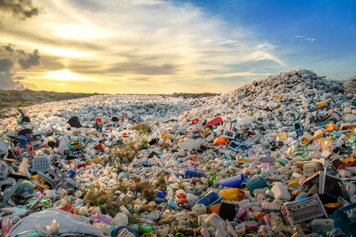
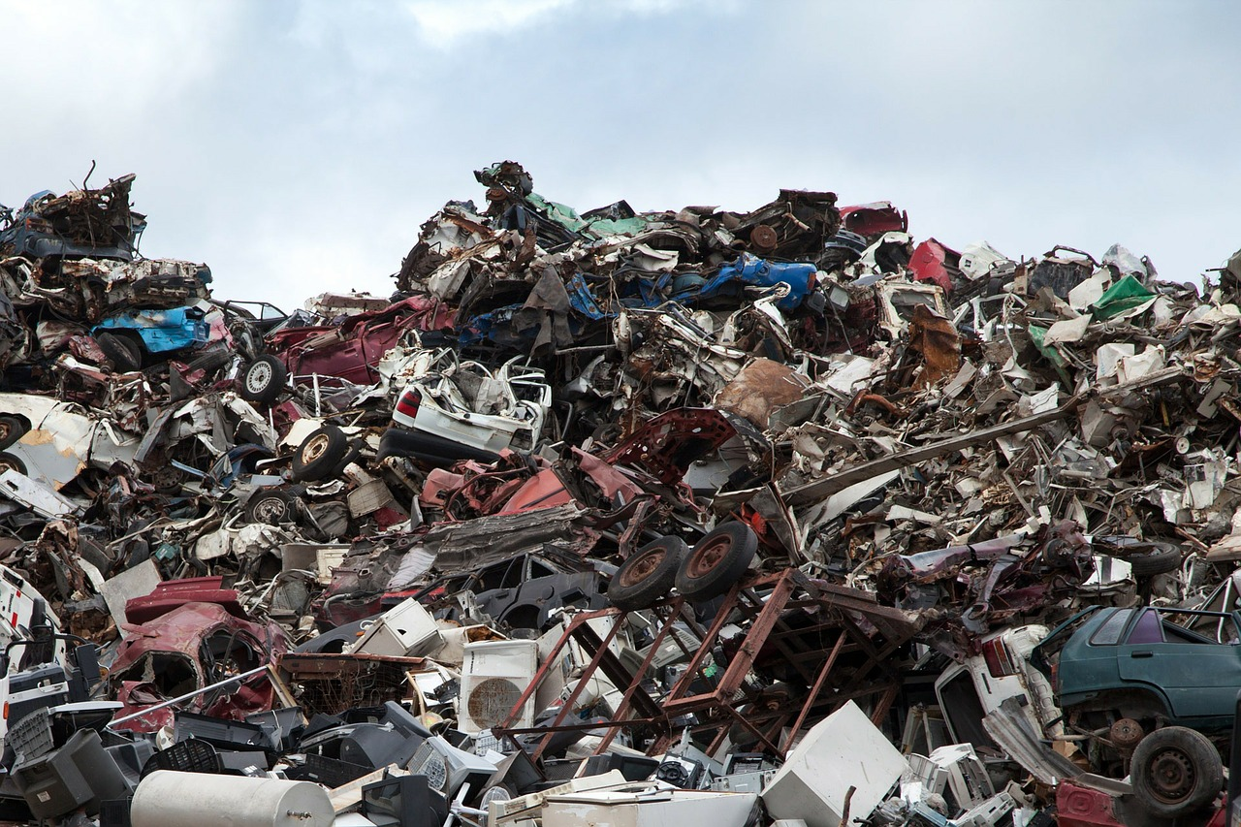
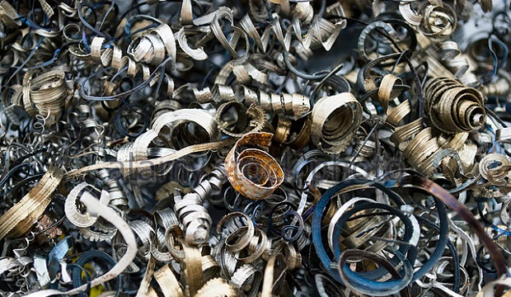
Waste
We humans generate a lot of waste which affects:
  Air
  Water
  Land
Some of the main types of Wastes:
  Municipal, which includes household, commercial and demolition waste;
  E-waste, which includes computer parts, other electronics;
  Radioactive waste
  Manufacturing Material waste.
https://www.wm.com/content/dam/wm/documents/RecyclingResources/Posters-Guides-Tools/Recycling-Myths.pdf
https://www.conserve-energy-future.com/sustainable-practices-waste-management.php

Slide 16

What is Sustainable Waste Management?
Sustainable Waste Management refers to the practice of
managing and monitoring the
Collection, Transportation, Processing or Disposing
the various waste materials
not jeopardize the environment, human health or future generations.
https://www.wm.com/content/dam/wm/documents/RecyclingResources/Posters-Guides-Tools/Recycling-Myths.pdf
https://www.conserve-energy-future.com/sustainable-practices-waste-management.php

Slide 17
Goals of Sustainable Waste Management
Waste Management Hierarchy
Prevention: Simply avoiding the generation of waste, including increasing quality in production, longer product lifetime, safe and environmentally friendly material.
Prevention
Most
Preferred
Reduction & Reuse: Reduction waste and reuse of substance, product or material again.
Reduction & Reuse
Recycle: Turning waste into a new substance or product.
Recycle
Recovery: Energy recovery from waste! Into usable heat, electricity, or fuel through a variety of processes including combustion, gasification, etc.
Recovery
Disposal: Landfill
Disposal
Least
Preferred

Slide 18
Sustainable Waste Management vs. Industry 4.0
Reduce Material Waste through Simulation. Manufacturers can see a virtual view of the machines, lines, and factory before making a product helping them set up production flows efficiently reduce material use and waste.
Lowering Energy Consumption through Digital Twins. Can create the optimal facility layout and location design on the factory floor and managing machines idle times lowering energy consumption
Increasing Quality and Product Lifetime through Robotics and Digitalization. By Robotics and Digitalization machines operate at peak efficiency using high-speed automation, sensors and actuators, and removing human errors increasing quality products faster and cheaper with longer life span
Better Employee Experience through IoT. IoT and other Automation solutions capture data during manual processes, leveraging detection capabilities, as well as reducing work injury risks improving ergonomic, safe and sustainable work environment
Notes:
https://flex.com/resources/3-ways-industry-4-is-driving-sustainability-in-manufacturing

Slide 19
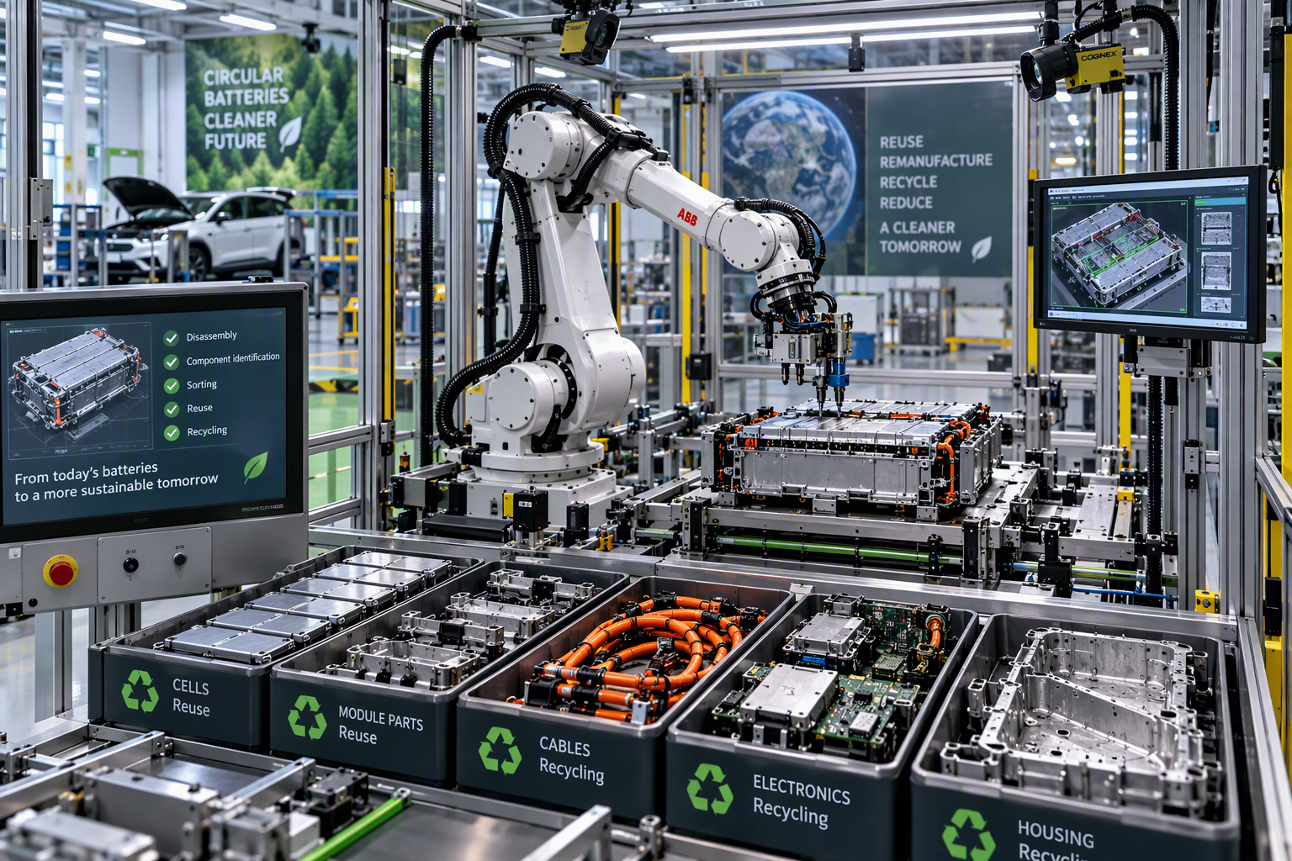
CIRCULAR PRODUCTION
Case: Robotic Battery Disassembly
CHALLENGE
Returned battery packs vary in condition and may expose workers to electrical, thermal and ergonomic hazards.
ROBOTIC APPROACH
Machine vision identifies pack variants. A robot performs controlled opening, component removal and sorting for reuse, remanufacturing or recycling.
WHAT TO MEASURE
• Recovered material and component yield
• Energy use per processed pack
• Cycle time and operator exposure
Evaluate total lifecycle impact, not only recycling rate.
Illustrative case for discussion
Notes:
[Sources]
Visual on this slide was generated with Microsoft Copilot.
Case content is an illustrative teaching example.
[/Sources]

Slide 20
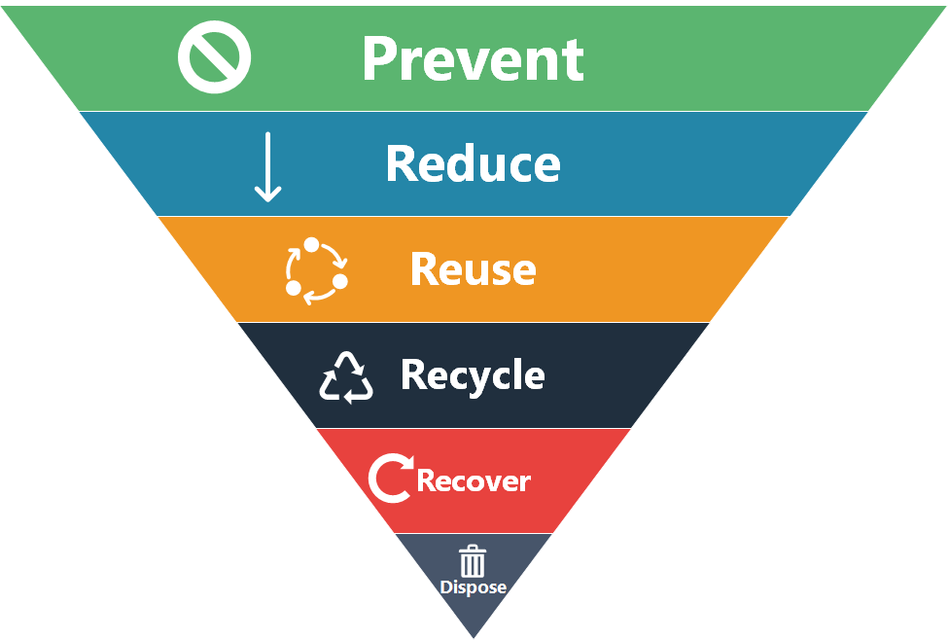
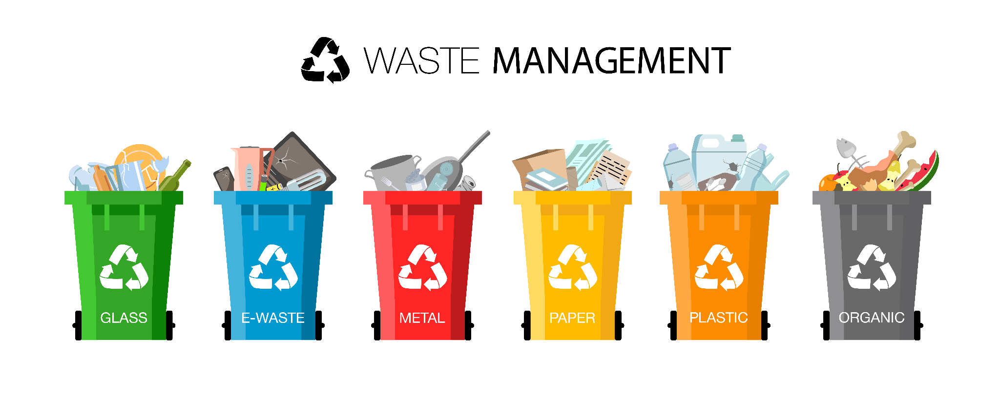

Guidelines to Improve Resource Efficiency and waste management in Your Business
Preventing wastes.
Reducing wastes.
Improving waste management practices.
Improving recording and reporting within your business.
Improving purchasing to reduce waste.
Reuse as much as possible.
Strategies for recycling.
Improving storage and inventory management.
Conserving energy and water.
Updating systems to improve operations and staff support.
Avoid contamination like keeping waste out of drains.
Reducing odor and air emissions.

Slide 21
Industry 4.0 and 5.0

Slide 22

How Industry 4.0 Impacts Sustainability
Industry 4.0 is a new automation trend in industry and enables improvements in production processes and systems through technologies such as:
Digitalization
Internet of Things (IoT)
Robotics
Systems Integration
Big Data, Artificial Intelligence (AI) & Machine Learning (ML)
Augmented Reality (AR)
Cloud Computing
etc.
United Nations Industrial
Development Organization
https://www.unido.org/sites/default/files/2017-08/REPORT_Accelerating_clean_energy_through_Industry_4.0.Final_0.pdf

Slide 23
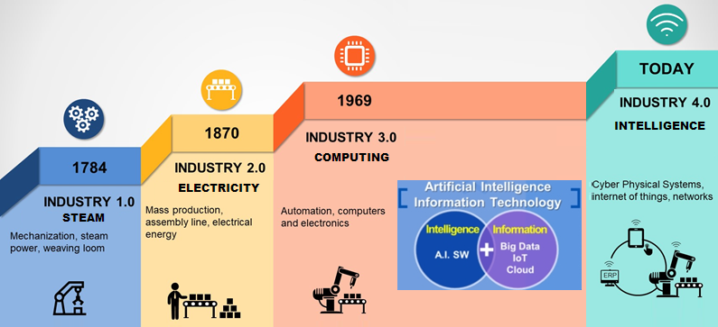
Industry 4.0
Industry 4.0 is the current trend of Automation and Data Exchange in manufacturing technologies.
Autonomous Products and Decision-making Processes in near real-time!
Notes:
1 – introduction of mechanical production line (late 18th century
2- technologies of mass production (late 19th and early 20th century)
3- automation of production through electronics and IT
4- autonomous products and decision making processes, control value-added network in near real-time.

Slide 24
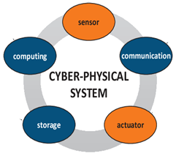
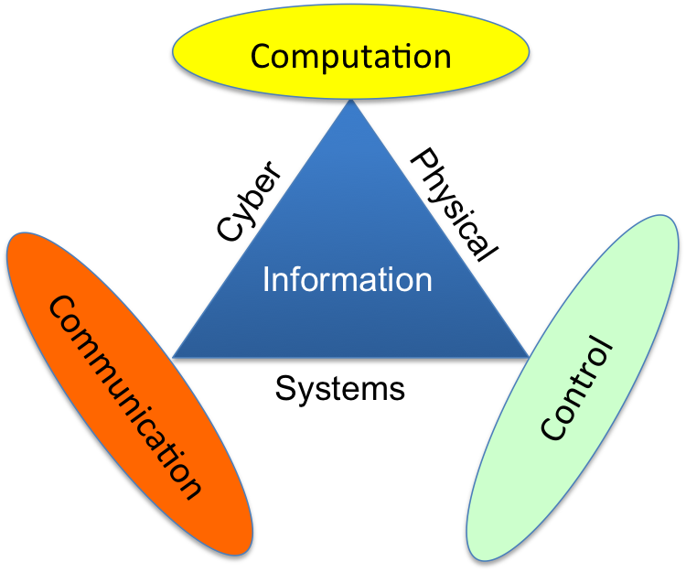
Cyber-Physical System (CPS):
CPS is a mechanism that is
Controlled or monitored by Computer Algorithms
Deeply integrated or a network of Cyber (software) and Physical Part of the system.
Unlike embedded systems, CPSs are not standalone devices.
CPS is like Internet of Things (IoT), sharing the same basic architecture, But CPS presents a higher combination and coordination between physical and computational elements.

Slide 25
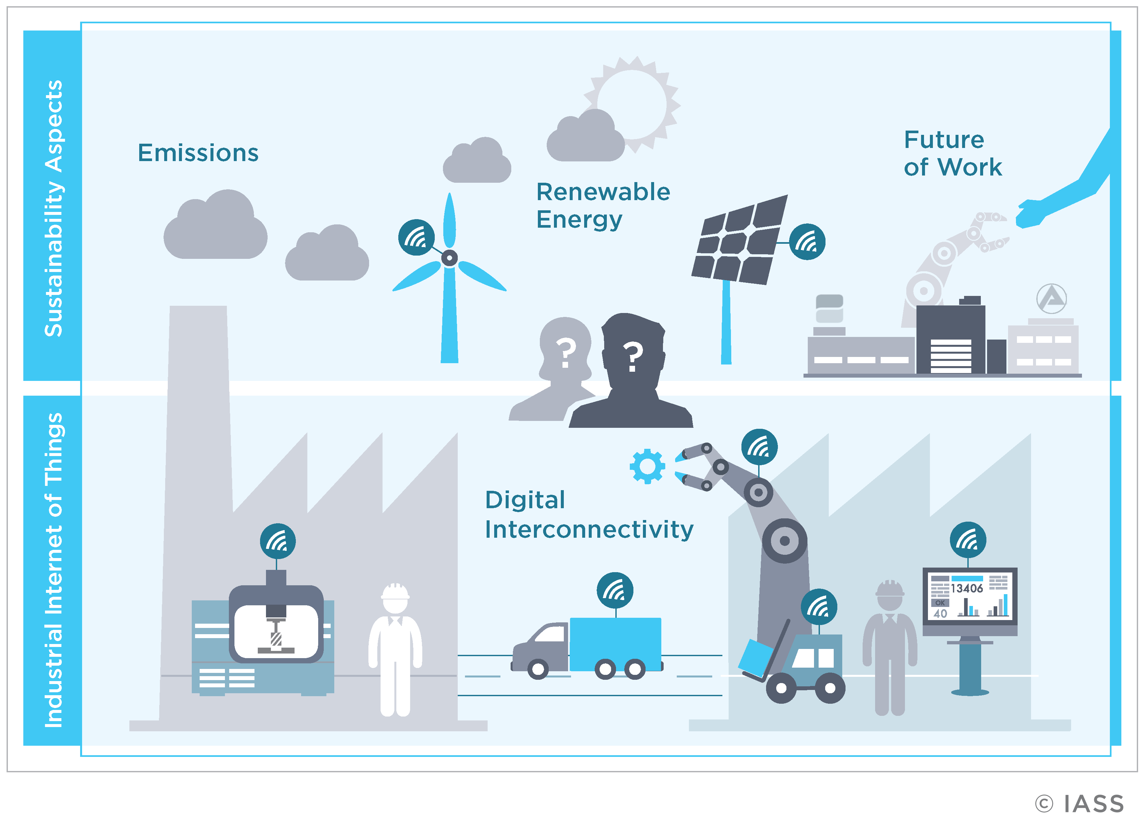

How Industry 4.0 Impacts Sustainability
Industry 4.0 accelerates the deployment towards:
Renewable Energy
Reduce Carbon Emissions
Optimize Energy Use
Enhance Productivity
Cost Reduction
https://www.unido.org/sites/default/files/2017-08/REPORT_Accelerating_clean_energy_through_Industry_4.0.Final_0.pdf

Slide 26
Industry 4.0 – Data & Visibility for Sustainability
Gathering real-time data through Industry 4.0 technologies allows manufacturers to:
To reduce carbon emissions (across sourcing, production, packaging, distribution, and disposal). For example, data showing energy consumption by machines can help as input to identify avenues for better management.
To increase the productivity through monitoring real-time production and other operations’ status. For example, for efficient management of the idle machines and other resources and systems. Real-time quality control helps avoid scrap and prevent waste!
To enable sustainable product design in alignment with 4 Rs (Reduce, Reuse, Recycle, Recover).

Slide 27
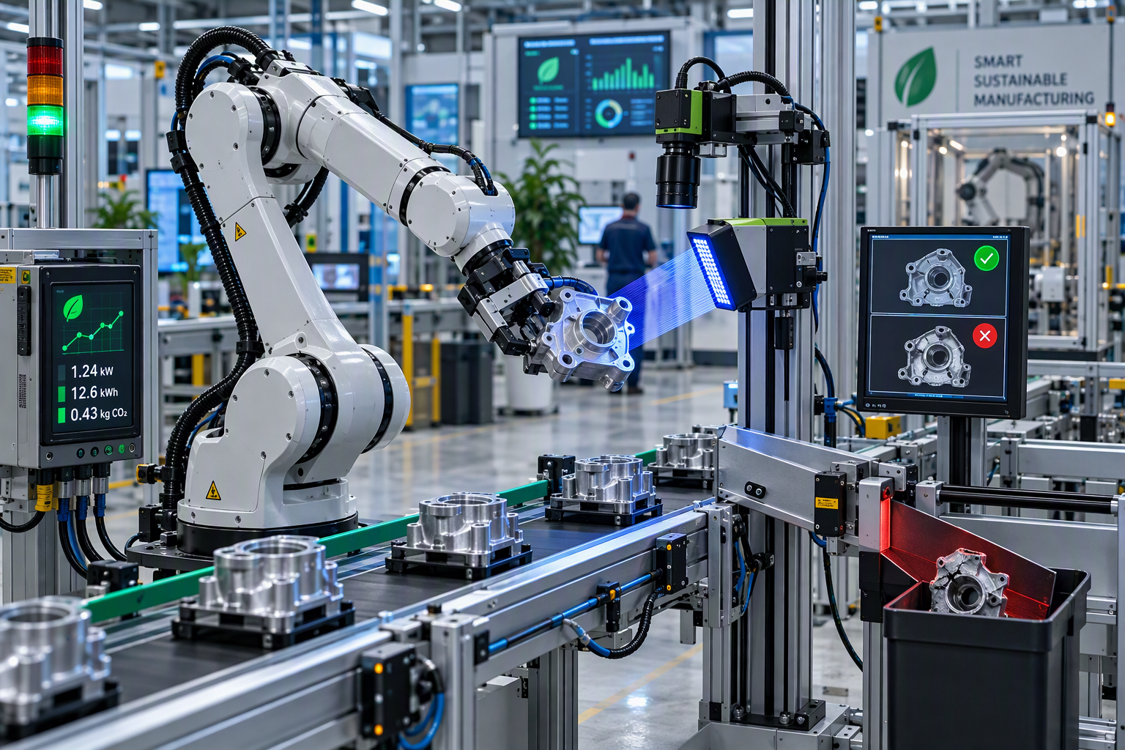
WASTE PREVENTION
Case: Robot-Assisted Quality Inspection
CHALLENGE
Late detection of defects creates scrap, rework and unnecessary energy and material use.
ROBOTIC APPROACH
A robot presents each part consistently to a vision system. Process data supports earlier correction and separates confirmed defects from acceptable variation.
WHAT TO MEASURE
• Scrap and rework per approved part
• Inspection energy per part
• False reject and missed-defect rates
The benefit depends on avoided waste versus added system impact.
Illustrative case for discussion
Notes:
[Sources]
Visual on this slide was generated with Microsoft Copilot.
Case content is an illustrative teaching example.
[/Sources]

Slide 28
Industry 4.0 - Intelligent for Sustainability
AI / ML help in analysis and decision making for processes that are involved with the accomplishment of sustainability goals mainly:
To maximize operational efficiency. For example, at
Automated and connected Electric Vehicles. AI helps and operates on decisions like routing, traffic optimization, eco-driving algorithms, etc.
AI-driven warehousing & logistics operations. Optimizing the delivery route of transportation management systems in real-time.
Both lead to efficiency, conserving resources, and minimizing the waste and pollution.
https://www.cognixia.com/blog/how-can-machine-learning-help-save-the-environment/

Slide 29
Industry 4.0 - Connectivity for Sustainability
IoT systems enable a circular economy, based on the principles of reduce, reuse and recycle. With IoT-powered solutions, organizations can
Smart Energy Management
Air Pollution Monitoring
Smart Waste Management
Fleet Management
Smart Water Management
Smart Farming
Cold Chain Monitoring
https://behrtech.com/blog/iot-and-sustainability-7-applications-for-a-greener-planet/

Slide 30
Guidelines to Improve Sustainability through Industry 4.0 in Your Business
Sustainability control tower helps companies transform into intelligent and sustainable enterprises based on financial and environmental, social, and governance (ESG) indicators.
Design products that are recyclable and environmentally sustainable. Up to four-fifths of a product’s lifetime emissions are determined by decisions made at the design stage.
Plan resources and inventories to reduce emissions and companies’ overall environmental impact
Source materials that eliminate slave labor and ensure fair trade regulations
Optimize manufacturing processes to minimize adverse environmental impacts while conserving energy and natural resources and establishing safe working conditions
Deliver with logistics processes that optimize loads to reduce mileage and carbon footprint
Leverage the power of the network to support a circular economy
Notes:
https://blogs.sap.com/2022/04/11/industry-4.0-helps-manufacturing-companies-accelerate-their-sustainability-journey/
https://www.unido.org/unido-industry-40
https://blogs.sap.com/2022/04/11/industry-4.0-helps-manufacturing-companies-accelerate-their-sustainability-journey/

Slide 31
Industry 5.0
Industry 5.0 complements and extends I4.0. It reaffirms the environmental and social factors, and not just economic or technological, by framing how industry and emerging societal trends and needs can co-exist
By developing innovative technologies in a human-centric way, I5.0 can support and empower, rather than replace workers; by doing so, the industry can increase its resilience and make it more sustainable.
Greening the economy will require that industry takes strong leadership. I5.0 environmental goals can be achieved by incorporating new technologies and rethinking production processes in respect to the environmental impacts

Slide 32
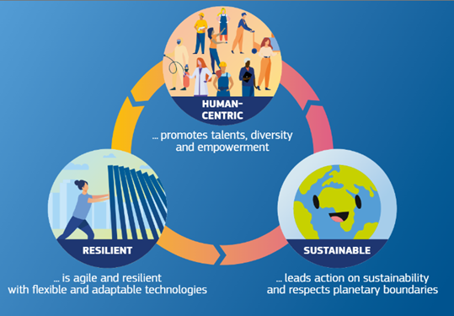
I5.0 Model
Shortcoming of I4.0! In a globalized world, the focus on profit fails to account correctly for environmental and societal costs and benefits.
I5.0 addresses all of the I4.0 shortcomings in revisit and reaffirm the human, environmental, and societal impacts
It includes responsible innovation, that increases prosperity for all involved: investors, workers, consumers, society and the environment.

Slide 33
3 Pillars of Industry 5.0
Sustainable (consider all waste and potential by-products so that nothing harmful is dumped back into any stakeholders – witness the circular economy)
Human-centric (not just customer-centric, but very much staff-well-being / staff-centric also)
Resilient (to disasters, pandemics, floods, tech attacks, war, hyper-competition and more, plus embrace technology for good)

Slide 34
3 Pillars of Industry 5.0
In linear economy, raw materials are extracted, make products, and throw it away.
In circular economy, the goal is to prevent waste being produced in the first place.
Circular economy is based on 3 principles
Eliminate waste and pollution
Circulate products and materials
Regenerate nature

Slide 35
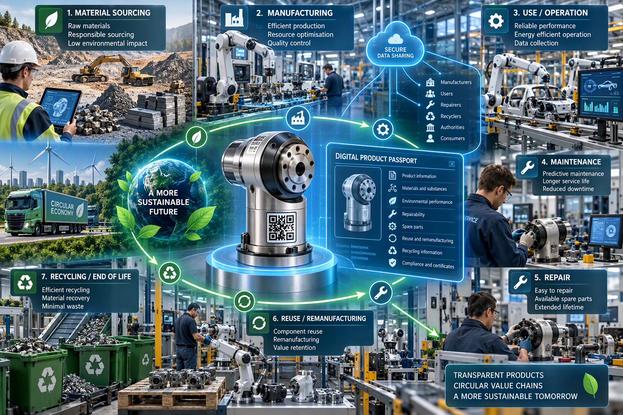
TRACEABILITY FOR CIRCULAR VALUE CHAINS
Digital Product Passport
WHAT IT IS
A digital container for information about products, components and materials.
WHAT IT CAN INCLUDE
Origin, materials, safety, environmental performance, repairability, reuse and recycling information.
WHO USES IT
Manufacturers, users, repairers, recyclers and public authorities.
WHY IT MATTERS FOR ROBOTICS
Machine-readable product data can support maintenance, component identification, disassembly and material sorting.
Legal basis: Ecodesign for Sustainable Products Regulation, EU 2024/1781
Notes:
[Sources]
https://single-market-economy.ec.europa.eu/single-market/digital-product-passport_en
Visual on this slide was generated with Microsoft Copilot.
[/Sources]

Slide 36
Sustainable Robotics and Automation
Sustainability Measurement

Slide 37
Sustainability Measurement Definition
Sustainability Measurement is a set of tools and methods that attempt to measure the degree of sustainability of processes, products, services, businesses and so forth.
Sustainability is difficult to quantify, perhaps even immeasurable. The metrics used to try and measure sustainability must involve the sustainability of environmental, social and economic domains, (both individually and in various combinations) and are still evolving.
The final goal and the needs for sustainability measurement include Sustainability Improvement through the operations, benchmarking performances, tracking progress, and evaluating process, among others.

Slide 38
Sustainability Measurement
Over the last two decades, there has been rapid growth in the number of quantitative methods used to assess sustainability.
It would be too difficult to list all those methods available at different levels of the organization so those listed here are at the global level (Macro level) only.
Some of the quantitative "tools" used by sustainability scientists are:
Benchmarks,
Indices,
Cycle,
Metrics/Indicators,
Auditing,
Reporting.

Slide 39
Index related to Robotics and automation
Life Cycle Assessment,
Life Cycle Costing,
carbon footprint,
energy measurement,
material flow analysis,
social risk/impact assessment,
robot-cell-specific KPIs.

Slide 40
Benchmarks
A benchmark is a point of reference for a measurement.
Once a benchmark is established it is possible to assess trends and measure progress.
Baseline global data on a range of sustainability parameters is available in the list of global sustainability statistics.

Slide 41
Sustainability Measurement - General Indicators
Few commonly used Indicators are:
Environmental
Economic
Social
Global warming potential
Acidification potential
Ozone depletion potential
Aerosol optical depth
Eutrophication potential
Ionization radiation potential
Photochemical ozone potential
Waste treatment
Freshwater use
Energy resources use
Gross domestic product
Trade balance
Local government income
Profit, value and tax
Investments
Employment generated
Equity
Health and safety
Education
Housing/living conditions
Community cohesion
Social security
Indicators are what we concern and measure and analyze!

Slide 42
Sustainability Measurement- Robotics Indicators
Few commonly used Indicators are:
Environmental
Economic
Social
kWh per approved part produced,
energy per robot cycle,
CO₂e per part produced,
scrapping and rework;
material exchange;
compressed air and cooling water consumption,
the life expectancy of the robot;
reusable or recyclable components.
life cycle cost, cost per approved product,
maintenance cost,
downtime,
repayment period,
the value of extended product or equipment life.
reduced ergonomic strain,
exposure to hazardous work tasks;
accident and incident data;
changing skills needs;
the operator's ability to control and influence;
the quality of human-robot cooperation.
Indicators are what we concern and measure and analyze!

Slide 43

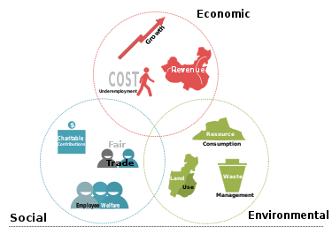
Auditing
Sustainability auditing and reporting are used to evaluate the sustainability performance of a company, organization, or other entity using various performance indicators. Popular auditing procedures available at the global level include:
ISO 14000
ISO 14031
The Natural Step
Triple Bottom Line Accounting
https://thenaturalstep.org/

Slide 44


Reporting
Some of the widely used sustainability measures include corporate sustainability reporting, Triple Bottom Line accounting, World Sustainability Society, and estimates of the quality of sustainability governance for individual countries using the Environmental Sustainability Index and Environmental Performance Index. The UN Human Development Index and the ecological footprints are methods to monitor sustainable development over time.
Global Reporting Initiative also known as GRI are mainly known for modelling and monitoring procedures. Many of these are currently in their developing phase.
State of the Environment reporting provides general background information on the environment and is progressively including more indicators.
Sustainability standards and certification systems like Fairtrade and Organic certifications (e.g. KRAV)

Slide 45

Triple Bottom Line Accounting
The Triple Bottom Line Accounting (TBL) is an accounting framework that incorporates three dimensions of performance: social, environmental and financial.
This differs from traditional reporting frameworks as it includes ecological (or environmental) and social measures that can be difficult to assign appropriate means of measurement.
The TBL dimensions are also commonly called the 3 Ps: people, planet and profits.

Slide 46
Sum Up – Standards, Types, categorization
What are the Standards for sustainability measurement actually then?
Over time, there have been dozens of published indication sets by different bodies which include universities, standards organizations, government institutions, and more. Some examples of the most prominent and widely used standards include:
Global Report Initiative (GRI): this is a voluntary sustainability reporting project for organizations that consists of 70 indicators.
United Nations - Indicators of Sustainable Development (UN-CSD): assesses the level of sustainable development of a country or region and contains 96 indicators.
International Organization for Standardization (ISO) Environment Performance Evaluation (EPE) standard (ISO 14031): this standard was designed to help organizations develop their own indicators for environmental performance measurement.

Slide 47
Challenges in Sustainability Implementation
Lack of knowledge
Despite the growing public interest in sustainability, misconceptions and knowledge gaps still exist.
This has led to a recent increase in related educational resources.
Search for “sustainability,” and you’ll find tons of offerings on Coursera and results on LinkedIn Learning. Many of these resources specifically target teaching employees about the SDGs.
Both the need for understanding concepts and the difficulty of attaining this mastery have been identified as challenges. But establishing a culture of sustainability requires more than assigning another training that employees won’t find relevant or remember.
If the goal is to create a learning environment that leads to long-term retention, companies must move beyond basic coursework. It is crucial that employers engage personnel in authentic, meaningful experiences.

Slide 48
Challenges in Sustainability Implementation
Lack of motivation
Employers strive to keep the members of their organization motivated, and for good reason.
Motivation “accounts for 40% of the success of team projects” and can increase employee productivity, satisfaction, and retention.
The lack of involvement in and enthusiasm in work and workplace presents an incredible challenge to organizations tied to performance indicators, such as taking part in sustainability initiatives.
Employers successful at engaging their workforce understand the need to establish a culture within which motivating personnel is routine. This should be a key focus for any organization looking to increase employee engagement in sustainability.

Slide 49
Challenges in Sustainability Implementation
Lack of experience
Another barrier to implementing sustainable practices companies face is that many people lack the experience and confidence necessary to act as champions of sustainable practices.
Educating and engaging employees are necessary first steps. However, “research studies increasingly indicate that in order to motivate such engagement, people need to become personally involved with sustainability at a psychological and emotional level”.
To encourage this involvement, organizations can ensure opportunities exist for employees to observe and practice sustainable behaviors, build confidence in their abilities, and take ownership.
Increase in self-efficacy regarding sustainable practices could be fostered in employees if appropriate workplace supports are established.

Slide 50
Sustainable Robotics Design Principles
Energy efficient operation
Modular design
Repairability
Reusability
Remanufacturing
Recyclability

Slide 51
Sustainable Robot Cell KPIs
kWh/part
kg scrap/part
CO₂/part
MTBF
Downtime
Ergonomic improvement

